Slide 1

Dream Role - Skill Gap
KPR Institute of Engineering and Technology
INNOVSENSE 2026
Team Head & Dept :Akash A-AI&DS
Department | Students
B.tech - AI&DS B.tech -AI&DS B.tech -AI&DS B.tech -AI&DS B.tech -Chemical engineering | Akash A 23AD005 Sarathy C 23AD055 Srinath S 23AD057 Varun S 23AD064 Surya Prashanth K 23CH062

Slide 2
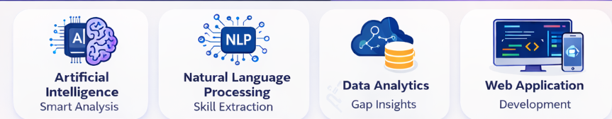
Problem Statement & Tech Domain
Many students apply for jobs without knowing if their resume matches the required skills for their target role.
Existing resume analysis tools use large generic skill lists, leading to unrealistic skill gap results.
Different roles require specific core skills rather than a long list of unrelated technologies.
A role-based skill gap analysis system is needed to identify missing skills and suggest resume improvements.

Slide 3
Novelty
Existing method | Suggested method | Reference (after 2020 research papers)
Generic resume skill matching | Role-based skill comparison (6–8 core skills) | IEEE – Skill Gap Analysis (2021)
Only resume checking | Weak area detection + improvement suggestions | Springer – AI Career Recommendation (2022)
No career guidance | AI mentor guidance + career roadmap | ACM – AI Career Guidance (2023)

Slide 4
Required Hardware/Software
1.Hardware
Laptop / Desktop Minimum 8 GB RAM Internet Connection
2..Software
Frontend: React.js, HTML, CSS, JavaScript Backend: Node.js Database: Firebase Firestore Authentication: Firebase Authentication AI Integration: OpenAI API

Slide 5
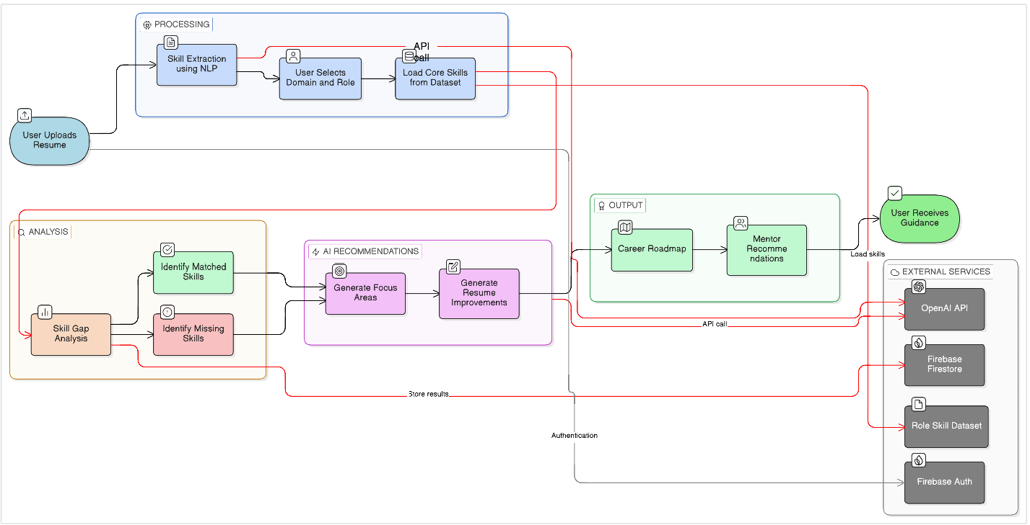
Methodology (Block diagram/Circuit diagram/Flow diagram)

Slide 6
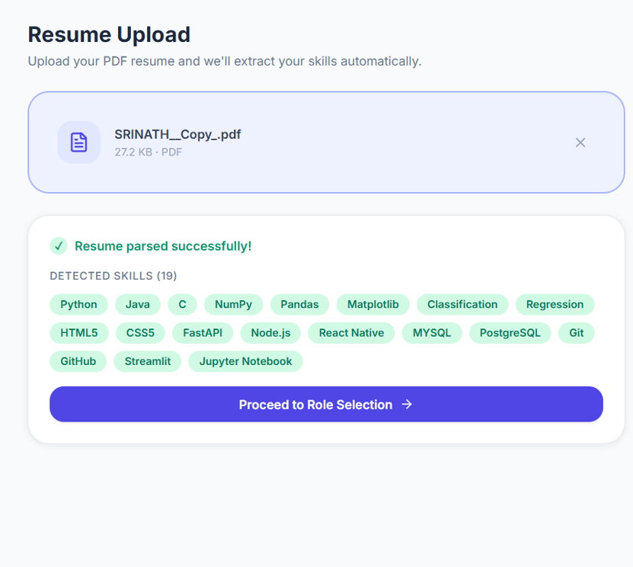
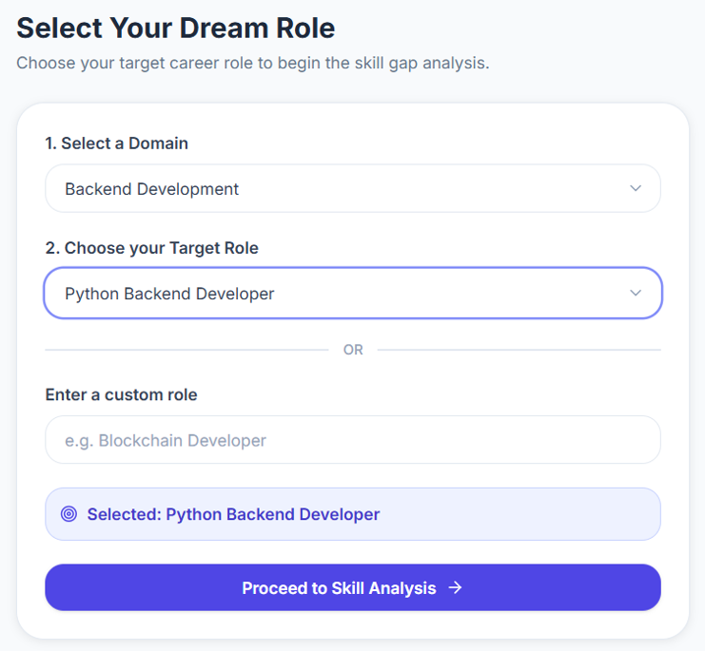
Simulation developed

Slide 7
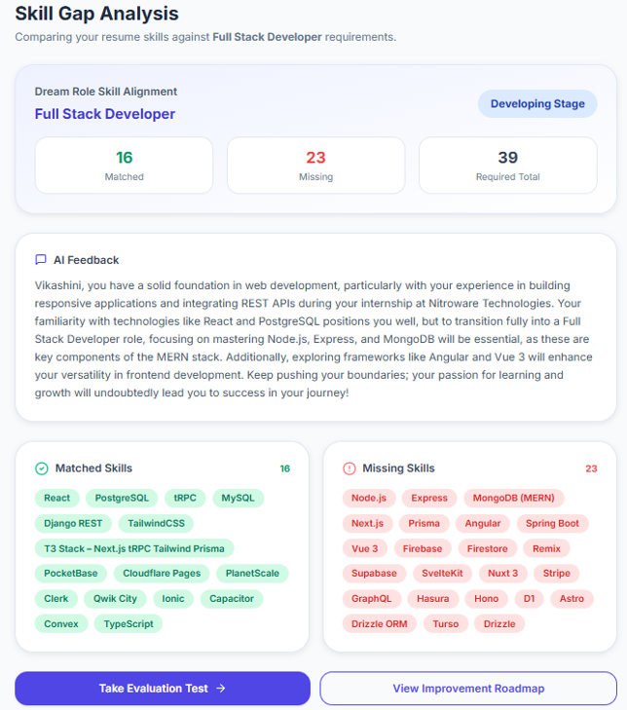
Output generated

Slide 8
Rate the project Suitability for/patent/research/product/Startup on scale 1(low) -3(High)
Suitability | Scale | Comment
Patent | 1 | Concept based on existing technologies
Research | 2 | Useful for academic research in career guidance
Product | 3 | Can be developed as an EdTech platform
Startup | 3 | High potential as an AI career development platform
Which Industry will use this product? | EdTech Platforms,Career Guidance Platforms,University Placement Systems.
Are you willing to make the project as a StartUp? | Yes, the platform can be expanded into a scalable AI-driven career guidance product

